Slide 1
Letters: Formal Letters,CV/ Resume Email writing
Department of Humanities & Social Sciences

Slide 2
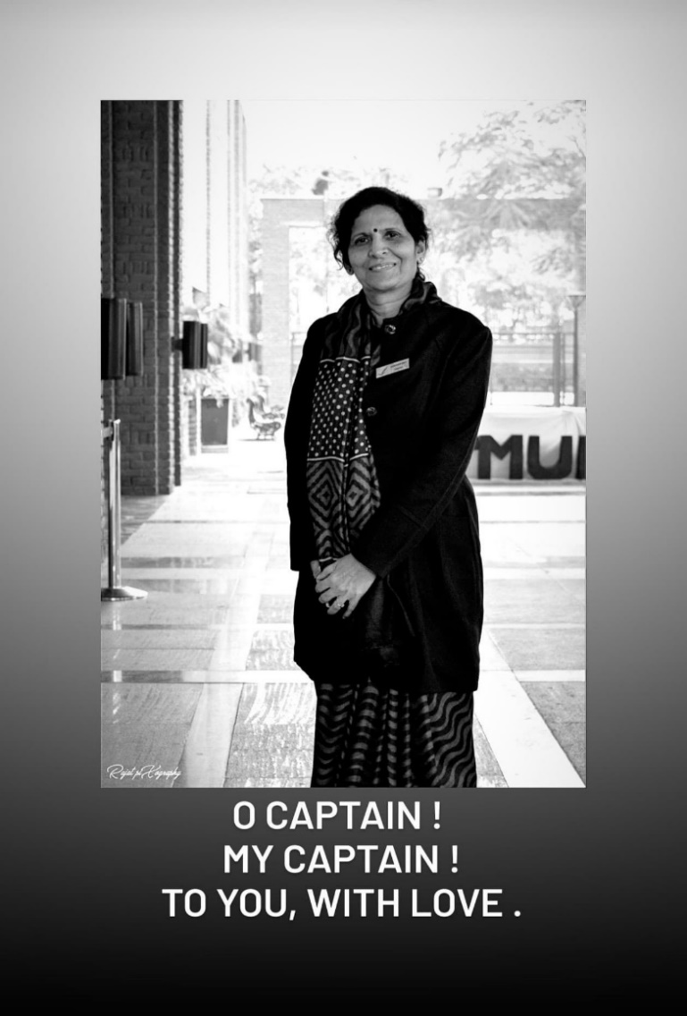
A Tribute to Late Dr Santosh Dev Ma’am
This is the last lecture slide prepared by Late Dr Santosh Dev Ma’am, who suddenly left us all, for her heavenly abode on November 25,2020. She was one of the most important faculty members who laid the foundation of our Department of Humanities & Social Sciences at Jaypee Institute of Information Technology, Noida. She was the guiding force who structured the entire course of English for B.Tech students in the beginning along with Ms Puneet Pannu and Dr Nilu Choudhary. She also seeded the elective of Literature in the Department.
As a person, we all will remember her always as the guide, mentor and affectionate motherly figure to not only her students, but to many of her younger colleagues as well; and as the soul who truly embodied the spirit of never to give up attitude, who worked till her last moment of consciousness. She epitomized the spirit of diligence, hard work, perseverance, patience, affection and above all, highest form of will power.
The void left by her sudden demise can never be filled up, but lessons we have learnt from her can always guide us forever.
We all will always love you, remember you & miss you, our beloved Santosh ma’am.

Slide 3
A Tribute by Alumnus Prateek Babbar
“It is shocking to hear that ma’am is no more with us. I close my eyes to remember her and I always see her smiling with serenity in her eyes. Perhaps, I have never seen her without a smile. There was a sense of calmness, a motherly affection in her personality. She has so many students and she knew each one personally. One rarely comes across a teacher like her who went beyond her duty to nurture and inspire her students with encouragement and appreciation. I feel blessed to have a mentor like her. Santosh Ma’am, may you guide us from the heavens, the way you have guided us here. Rest in Peace.”

Slide 4
Key Points to be Covered
Definition
Letter Writing Etiquette
Why letter writing matters
Aim of letter writing
6 Cs of good letter writing
Structure of a Letter
CV/Resume
Email Writing
Resources for further consultation:
Chaturvedi. P.D ( 2011). Business Communication: Concepts, Cases, and
Applications, Second edition, Pearson Education India.
Its online availability site:
https://docs.google.com/viewer?a=v&pid=sites&srcid=ZGVmYXVsdGRvbWFpbnxvbG
Vya2RyZXN8Z3g6MjU4MTc4NTNmMTdjMWVjNg
Rizvi, A. R. ( 2018) ‘Effective Technical Communication’ 2nd edition, McGraw Hill
Education Private Limited, Chennai.

Slide 5
Definition :Letter
“A written or printed communication directed to a person or organization.”

Slide 6
Letter Writing Etiquettes
Etiquettes are good manners or appropriate or accepted social practices that reflect and promote civility.
​
When should you write a letter?
To thank someone who has been gracious, kind or helpful to you
​
When you need assistance or answers to help you make intelligent decisions.
​
To respond to a letter or letter request that you have recently received. (do not wait too long)
​
To create legal documents that record information and support claims.
​
To show that you are a courteous and professional.

Slide 7
Why letter writing matters
“A writer, writing away, can always fix himself up to make himself more presentable, but a man who has written a letter is stuck with it for all time.” E. B. White
Letters should be truthful as they may become a permanent record of what you know, think or feel at the time you are writing the letter.
​
Letters have come back to haunt many people.
​
Letters reflect your character and personality

Slide 8
Aim of letter writing
To persuade your reader to agree to what you say, and to act accordingly
We are living in a technology driven world and we prefer Emails, text etc.
Nevertheless, letters still have importance and a major use in Indian society.
We must know how to write formal letters because they generally stay on record.

Slide 9
6 Cs of good letter writing
Clarity Completeness
Conciseness Consideration
Correctness Courtesy
Notes:
Six Cs of Business Communication - Farmer School of Business
www.fsb.miamioh.edu › HWI-handout-CsofBusComm

Slide 10
Structure of a Letter
Sender’s Address
Date
Reference
Inside address
Attention Line
Salutation
Subject
Body
Conclusion
Signature
Enclosures

Slide 11
Date
The date line indicates the date the letter was written
Use the American date format (place the month before the day)
For example: October 22, 2020

Slide 12
Heading/Sender’s Address
One line below the date
Sender’s name (in case of a company or firm)
Address
Telephone no.(optional)
Telex number.(optional)
Fax number.(optional)
E-mail address (optional)
Website .(optional)
Printed or typed in the middle of the page
If written by hand, it should be on the left hand side

Slide 13
Example of Heading/Sender’s Address
GUPTA ENTERPRISES 7, Barakhamba Road
New Delhi-ll000l
No sender’s address is mentioned if both the sender and the receiver belong to the same organization.

Slide 14
Inside address
Receiver’s full name and designation
Address as on the envelope
Written on the left hand side
In ordinary cases, Mr., Mrs., or Ms is used
Name of the company if there is no name or Designation
Messrs or M/S is used if the company has a nominal feature in its name

Slide 15
Salutation
On the left hand side
Two spaces below the inside address
It’s the greeting of the addressee
It’s the written equivalent of ‘Hello’ used in conversation
In case of an organization, Dear Sirs is used
In case of an officer or designation Dear Sir or Sir is used, the former being less formal

Slide 16
Sir/ Madam For official correspondence
Dear Sir/ Dear Madam For business correspondence
Dear Sirs/ Dear Mesdames For firms
My dear…… For informal letters

Slide 17
The Subject Line
The purpose of the letter in brief
Like a newspaper headline
Should be underlined or highlighted

Slide 18
Body of the letter
Two spaces below the salutation
Opening paragraph
Main paragraph
Closing paragraph
(No. of paragraphs vary with type of letter/content)

Slide 19
Opening paragraph
Designed to attract the reader’s attention
Should open with acknowledgement or gratitude
or
With a reference to the previous letter
or
Introduction specifying the nature of business or
the occasion for writing the letter

Slide 20
MAIN PARAGRAPH
Contains all the relevant details
Should be brief and precise
Should be written in simple and clear words
Avoid ambiguity

Slide 21
Closing paragraph
Should restate the purpose of the letter
Request some type of action
Some examples-
We look forward to receiving an early reply from you.
These goods are needed to execute our customers’ urgent orders; hence we look forward to getting a prompt reply from you.

Slide 22
Complimentary close
Four spaces below the body of the letter.
On the left hand side.
Examples-
Yours sincerely / Yours faithfully / Yours truly

Slide 23
SIGNATURE
Lends authenticity to the letter
Without signature, a letter has no value at all
Placed below the complimentary close
The name of the person signing the letter is typed below the signature

Slide 24
Enclosure
Two spaces below the signature
No. and brief details of documents

Slide 25
Letters of Job Application
Two types of letters of Application:
All information about qualifications, experience and personal details is given in first type of letter.
Second type has again two parts:
part one is a short covering letter, containing reference to the advertisement in response to which you are applying
part two consists of the RESUME/CV -a sheet which lists details about you and your qualification.This is more effective type of application.

Slide 26
How to capture attention in 8 seconds? ( Cover Letter)
make each cover letter fit the job you are applying for
use your experience and relate it to the job
express passion for the kind of work you will be doing
add something in the letter that states how what the organization does/mission fits with your values or interests

Slide 27
Example: heading/ first paragraph
Jake Ryan 2211 Riverside Avenue, Minneapolis, Minnesota 55454 612-555-5555 December 11, 2020 Jan Belmore Director Kids ‘n Kinship 14870 Granada Avenue Apple Valley, MN 55124 Dear Ms Belmore
I was excited to see your advertisement for the Youth Coordinator position on Augsburg College’s Career and Internship Center website. I have been looking for a position that would allow me to work with youth and make a positive impact in their lives.

Slide 28
MIDDLE PARAGRAPH
I recently graduated from Augsburg College with a bachelor of arts in psychology. During my senior year, I did an internship at Family Services where I coordinated and recruited volunteers for their Youth and Family Mentoring Program. Within that position, I was also able to do intakes, casework and develop an at-risk youth awareness program. My education, internship, work, and volunteer experiences have increased my abilities in the following areas: ▪Effectiveness in developing and implementing programs for youth and families ▪Excellent interpersonal and intercultural communication skills ▪Ability to recruit, interview, and retain volunteers ▪Effective intake and assessment skills ▪Successfully Supervised 20 first year students ▪Strong public speaking and training skills

Slide 29
LAST PARAGRAPH
My work, education, and leadership experiences have allowed me to grow both personally and professionally. I am passionate about your mission to help children grow and build relationships and believe that I can make an important contribution to the Kids ‘n Kinship organization. Enclosed is my resume for your further consideration. I thank you in advance and look forward to meeting with you soon. Sincerely, Jake R. Sample Jake R. Sample

Slide 30
What is a Resume?
a document to market your skills, experience, education, and accomplishments to employers
is meant to get you an interview
is NOT your life history
is very concise and easy to scan for information

Slide 31
What is a Curriculum Vitae (CV)?
a document that presents your qualifications for academic employment or graduate school
addresses your education, research, teaching, publications, presentations, professional development, and academic accomplishments
is rather lengthy and detailed
is a guide to where you have been academically and professionally

Slide 32
Basic Guidelines
utilize a 10 to 12 point, plain font
use consistency in your presentation
one page is preferred, but two pages are used when you have enough relevant experience
the most impressive related experience should be towards the top of the page
use action words to start your statements
include industry related buzz words
target it to the career field you are entering/job description you are applying for

Slide 33
A Resume is NOT a CV
A CV is used in academic and research-oriented job searches.
A CV is of flexible length
A CV is a record of your academic accomplishments and credentials.
A resume is used in business, non-profit, government and other types of job searches.
A resume should be 1 page, 2 pages max.
A resume is not all-embracing; it should be targeted to a particular job in a particular field.

Slide 34
Elements of a Resume
Objective
A targeted statement that clearly states the type of job you are seeking.
Good objectives are very specific
“To work with the design and development of new computer systems with a special interest in microprocessor application.”
“Position in public opinion polling or consumer product market research using skills in survey design and statistical analysis.”
Objectives are optional.

Slide 35
Elements of a Resume
Summary of Qualifications/Skills (Profile)
A summary of relevant skills, knowledge and accomplishments.
Be specific! Tailor this section to the job to which you’re applying.
If it is well written, this section can really help a potential employer to focus on your strengths.
Think carefully about what you have to offer.

Slide 36
Elements of a Resume
Education
Include degrees, expected date of completion if you have not finished, relevant coursework, and honors and awards (placed under the appropriate degree)
You might also consider placing your “Experience” section first.

Slide 37
Elements of a Resume
Experience
Think in terms of experience, not employment or work history.
Be sure to include internships and unpaid positions if they are relevant.
Be concise in your descriptions of what you did.
Do not use “Responsibilities included” or “Duties were.”
Translate specialized skills and interests into everyday language.

Slide 38
Elements of a Resume
Some additional/optional categories:
Professional memberships/Leadership
Community Activities/Leadership
(Computer) skills
Publications/Presentations (much briefer than on a CV)
Additional Information

Slide 39
Resume Dos
DO think of your resume as an ad for your qualifications, not an autobiography.
DO begin each bullet point with a verb.
DO included paid and unpaid experience to demonstrate the range of what you’ve done.
DO show the reader why you’re a good match for a particular job.
DO make several resumes, with each one targeting a particular field.
DO look at other resumes to see how they are written.

Slide 40
Resume Dos
DO use reverse chronology (the most recent position is your first entry) to organize your education and experience.
DO format your resume clearly.
DO proofread many times.
DO ask others to look at your resume.
DO a critique.
DO remember that most employers will only look at your resume for 15-30 seconds.

Slide 41
Resume Don’ts
DON’T make your reader dig for information.
DON’T tell everything you’ve ever done.
DON’T use complete sentences
DON’T include personal information, such as age, race, marital or health status.
DON’T make your resume too dense, busy or cute.
DON’T use a font smaller than 10 point.
DON’T use fancy fonts that are hard to read.

Slide 42
Where to Start for Grad Students
Think of the tangible skills you’ve gained.
For example: Have you taught? If so, you’ve gained valuable presentation and management skills.
Though not necessary, it helps to have fields in mind.
What skills have you acquired at your institute that might be of use to you in a given field?
Carefully consider your extra-curricular activities.

Slide 43
Writing a Formal Email
While an informal email can be sent quickly, writing a formal email takes a bit more thought and a bit more time. Careful consideration needs to be given to each email element.
https://business.tutsplus.com/articles/how-to-write-a-formal-email--cms-29793

Slide 44
common elements of a formal email:
1.Subject Line: Brief and concise
2. Salutation:The salutation directly addresses the person you’re sending the email to.
3. Introduction: If you are sending first time
4. Body:Clear, crisp and important information
5.Closing: your full name, designation etc

Slide 45
Learning & Relevance
The students will be able to read and write letters or letter requests carefully before responding.
The students will be able to understand the importance of reading and writing liters.
The students will apply letter-writing etiquettes.
They will be able to write Resume/CV and email

Slide 46
MCQ
1)How do you end the main body of a formal letter?
By telling the recipient what he should be doing next.
By talking about the weather in your city.
By talking about the weather in the recipient's city.
By expressing your love for the recipient.3.
2) In order to have the desired effect on the recipient what should a formal letter be?
In the proper format.
To the point and relevant.
Grammatically correct.
All the above.
3) The main point is written in which part of a formal letter?
Post script---. Closing---. Opening---.Body.
4) Which of these details should not be mentioned in your resume? a) Age b) Telephone number c) Health d) Nationality

Slide 47
References
(http://education.yahoo.com/ reference/dictionary/entry/letter)
https://docs.google.com/presentation/d/1yLvbY8OyBHA2lFeK0bSrqm7qFQfNTldB80AL9C3a6g0/htmlpresent
(http://education.yahoo.com/ reference/dictionary/entry/letter)
www.fsb.miamioh.edu › HWI-handout-CsofBusComm
Chaturvedi. P.D ( 2011). Business Communication: Concepts, Cases, and Applications, Second edition, Pearson Education India.
https://docs.google.com/viewer?a=v&pid=sites&srcid=ZGVmYXVsdGRvbWFpbnxvbG
Vya2RyZXN8Z3g6MjU4MTc4NTNmMTdjMWVjNg
Rizvi, A. R. ( 2018) ‘Effective Technical Communication’ 2nd edition, McGraw Hill Education Private Limited, Chennai.
Mishra, B. & Sharma, S.(2010) Communication Skills for Engineers and Scientists. First edition, PHI Learning Ltd.

